Slide 1
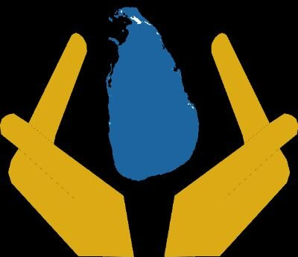
RESOURCE MANAGEMENT SYSTEM DMC

Slide 2
Identify Verify and Manage Islandwide Resources with a click of a button without a single sheet of paper used in the process.

Slide 3
1.
Overview

Slide 4
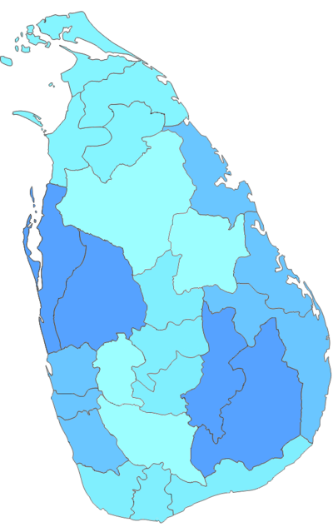
Combination of Sub sections and a Main Hub
DMC HEAD OFFICE

Slide 5
4 Types of Users
MainHub
(DMC Head office)
Sub Section
(District Level)
General Public
Sub Section
(GN Level)

Slide 6


2 States Of the System
General State
Consumes Less resources
Disaster State
Consumes More Resources
Dynamically Scalable

Slide 7
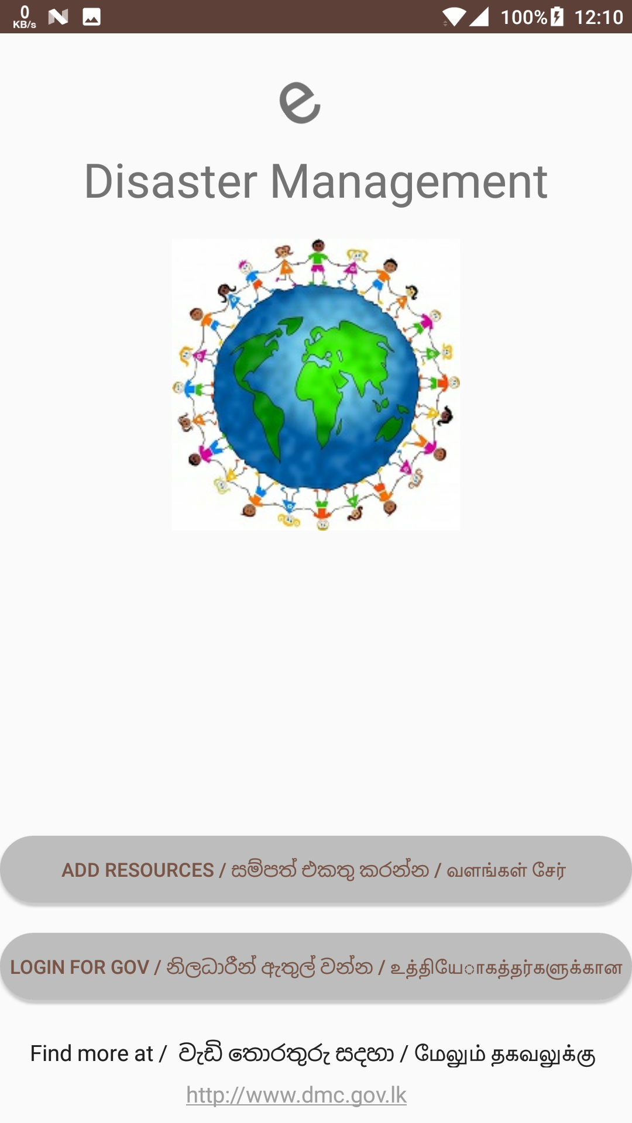
Simple User Friendly App For the GN and the Public Level user.
Used to validate Resource Persons and to enter additional Details
Supports All 3 Languages
Easy instructions
Supports older vertions
Place your screenshot here

Slide 8
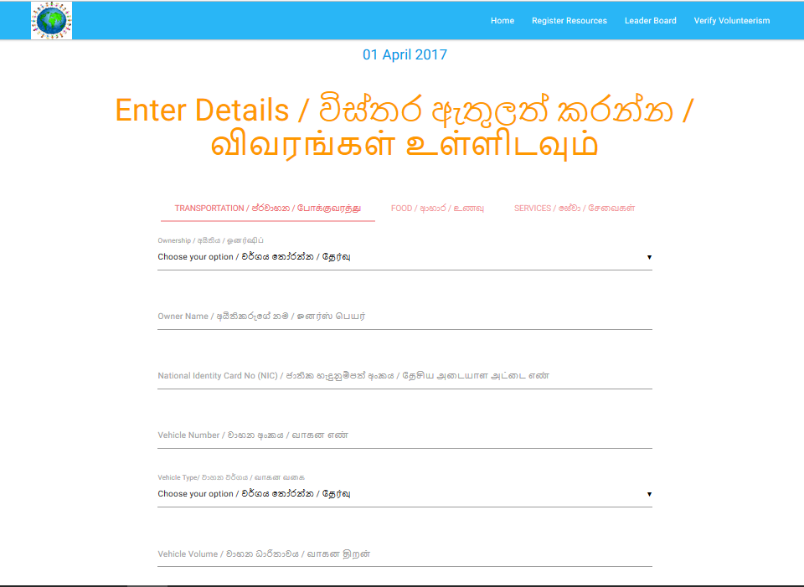
Web Portal
(District Level User)
Used to Verify Resource Persons.
Place your screenshot here

Slide 9
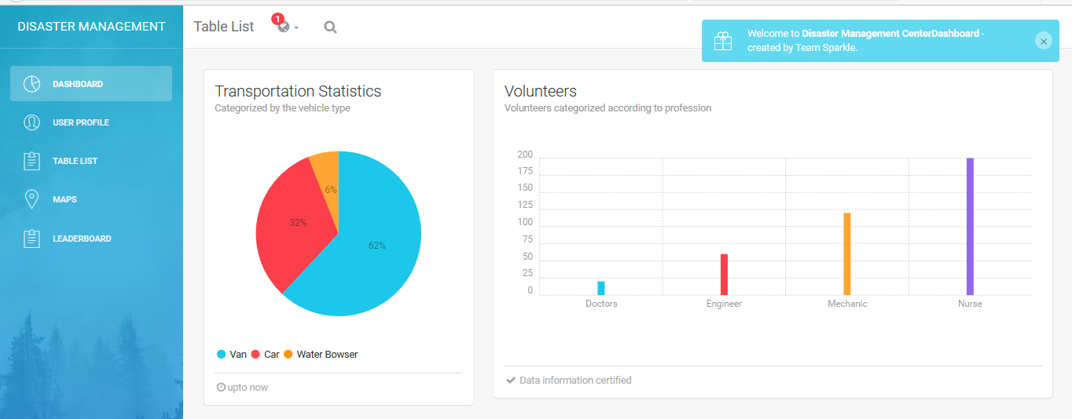
Place your screenshot here
Dashboard for DMC Admins
Realtime details of Resource flow
And Locations of Resources

Slide 10

Leader Board For the General user Leader
Making volunteerism FUN!!

Slide 11




Boosting Volunteerism !!!

Slide 12





Technologies Used
PHP,HTML5,JS
Symple and Effective
Android
Large user base
Google Maps API
Pinpoint Resources

Slide 13

2. Demonstration Session

Slide 14
Usual Process : 2 – 3 Weeks
Our Solution : 2 – 3 Days!!

Slide 15
How long will It take to deploy our service?only1.5Months!!
Planning And resource Allocation
Adding future Functionalities
Deploy Final web Service
2 weeks
4 weeks
6 weeks
Core Functions (Already Implemented)
Finalizing Functions for Final Deployment
Maintaining System

Slide 16
3.Future Enhancements and Functionalities

Slide 17

Using Open Source Platforms To Cut down Costs and Deployment time
Using Open source platforms such as SAHANA disaster management software
Using already available modules for easy development

Slide 18

DIALOG SMS API
Verification and Entering details with a singl sms throug a mobile phone SMART or NOT.

Slide 19

Resource – Resource Communication
Effective communication among similler resource persons Amplifying the Outcomes

Slide 20

Global Resource Network Conectivity
Communication amongst Nations to Provide and Request Resources during Desasters

Slide 21

4.Bussiness Model

Slide 22
Thanks!
Any questions?

